Slide 1







IBM Data Science Capstone Project | Space X | Falcon 9
Keamogetsoe Mphuthi
09/01/2024

Slide 2



OUTLINE
Executive Summary
Introduction
Methodology
Results
Visualization – Charts
Dashboard
Discussion
Findings & Implications
Conclusion
Appendix

Slide 3


EXECUTIVE SUMMARY
Methodologies:
Data collection and wrangling for preprocessing.
Exploratory Data Analysis (EDA) using data visualization and SQL.
Developed an interactive map using Folium.
Created a data dashboard using Plotly Dash.
Conducted predictive analysis with classification techniques.
Results:
Key insights from exploratory data analysis.
Interactive analytics demo presented via screenshots.
Successful predictive analysis outcomes.

Slide 4

PROJECT BACKGROUND & INTRODUCTION
Project Background:
This project aimed to predict the success of the Falcon 9 first stage landing. SpaceX offers rocket launches at a significantly lower cost ($62 million) compared to competitors ($165 million or more), largely due to its ability to reuse the first stage of its rockets. Predicting the likelihood of a successful landing helps estimate launch costs, providing valuable insights for potential competitors bidding against SpaceX.
Key Challenges:
Identifying factors influencing the rocket's successful landing.
Understanding how various rocket-related variables affect the success rate of landings.
Determining optimal conditions for SpaceX to achieve the highest success rate for rocket landings.

Slide 5
METHODOLOGY
Data Collection and Analysis Methodology:
Cleaned and prepared data for machine learning, including one-hot encoding and removing irrelevant columns.
Conducted exploratory data analysis (EDA) using visualization techniques and SQL queries, such as scatter plots and bar graphs, to identify patterns and relationships.
Created interactive visualizations using Folium and Plotly Dash.
Built, tuned, and evaluated predictive models using classification techniques.
Extract a Falcon 9 launch records HTML table from Wikipedia
Parsed the table and converted it into a Pandas data frame

Slide 6
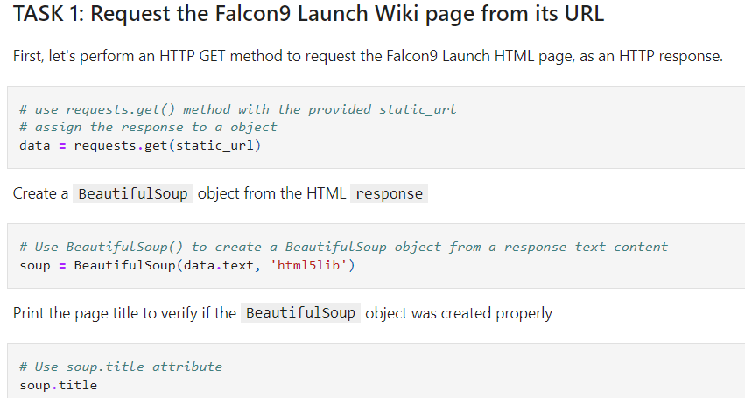
METHODOLOGY | WEBSCRAPING | DATA EXTRACTION
URL GITHUB REMEMBER

Slide 7
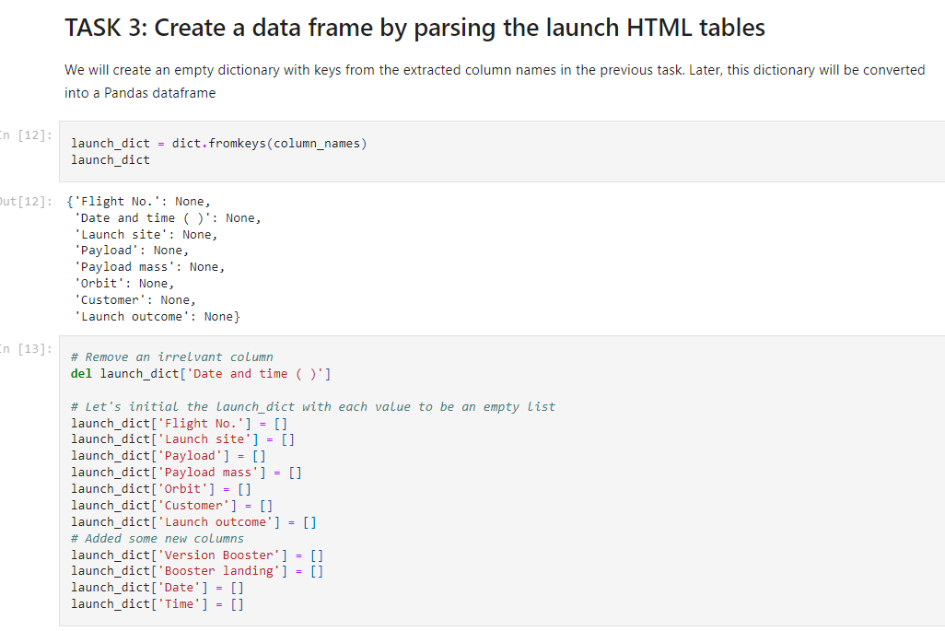

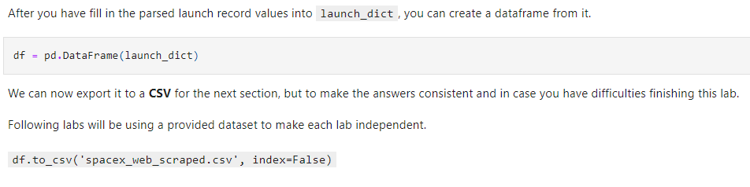
METHODOLOGY | WEBSCRAPING | PARSING
URL GITHUB REMEMBER
We can now convert the data to a CSV format

Slide 8
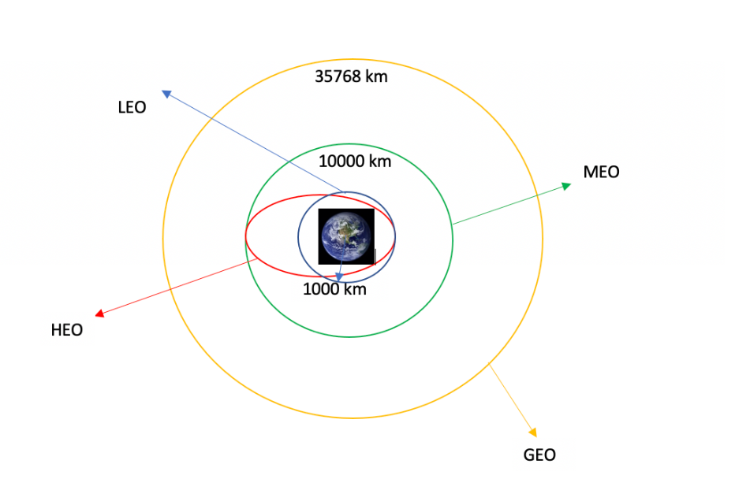

METHODOLOGY | DATA WRANGLING
Introduction to Data Wrangling
URL GITHUB REMEMBER
The dataset includes several scenarios where the booster did not land successfully. For example, "True Ocean" indicates a successful ocean landing, while "False Ocean" denotes an unsuccessful one. Similarly, "True RTLS" and "False RTLS" refer to successful and unsuccessful landings on a ground pad, and "True ASDS" and "False ASDS" represent successful and unsuccessful landings on a drone ship. These outcomes are converted into training labels: 1 for a successful landing and 0 for an unsuccessful one.
Process Conducted:
Performed Exploratory Data Analysis (EDA).
Calculated the number of launches per site.
Analyzed the number and frequency of each orbit type.
Evaluated mission outcomes by orbit type.
Exported dataset to a .CSV file.
Created landing outcome labels.
Each launch aims to an dedicated orbit, and here are some common orbit types:

Slide 9

METHODOLOGY | EDA AND INTERACTIVE VISUAL ANALYTICS
Flight Number vs. Payload Mass: Shows the correlation between the order of launches and the payload weight, indicating trends in SpaceX’s payload capacity over time.
Flight Number vs. Launch Site: Maps flight numbers to specific launch sites, highlighting frequency and patterns of site usage.
Payload Mass vs. Launch Site: Examines the variation in payload weights by different launch sites, reflecting site-specific capabilities or mission types.
Orbit vs. Flight Number: Displays the relationship between flight numbers and their targeted orbits, suggesting shifts in SpaceX’s strategic priorities or demand for certain orbital destinations.
Payload Mass vs. Orbit: Analyzes the association between payload weight and orbit type, revealing trends related to design constraints or mission preferences for specific orbits.
Orbit vs. Payload Mass: Highlights how payload mass is distributed across different orbital destinations, providing insights into the payload capabilities required for various orbital types.
Scatter Plots: Scatter plots illustrate the relationship or correlation between two variables. They are particularly useful when dealing with a large volume of data points, as they provide insights into how changes in one variable may be associated with changes in another, helping to identify trends, clusters, or outliers.
URL GITHUB REMEMBER

Slide 10

METHODOLOGY | EDA AND INTERACTIVE VISUAL ANALYTICS
URL GITHUB REMEMBER
Bar Graphs: Bar graphs provide a straightforward way to compare data across different groups. By representing categories on one axis and discrete values on the other, they effectively show relationships and can highlight significant changes in data, making them ideal for comparisons across categories or time.
Mean Payload Mass vs. Orbit: This bar graph shows the average payload mass for each type of orbit. By comparing the mean payload masses, it becomes clear which orbits typically host heavier or lighter payloads. This can provide insights into the types of missions usually undertaken for each orbital category.

Slide 11

METHODOLOGY | EDA AND INTERACTIVE VISUAL ANALYTICS
URL GITHUB REMEMBER
Line Graphs: Line graphs are effective for displaying data trends over time. They clearly show how variables change, helping to predict future outcomes based on existing data patterns. They are particularly useful when tracking changes over continuous intervals, such as years.
Success Rate vs. Year: This line graph displays the success rate of launches over time, plotted by year. It shows the percentage of successful launches per year and helps visualize trends in launch success. This can be crucial for understanding SpaceX's reliability and performance improvements or challenges over time.

Slide 12

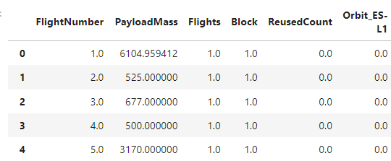
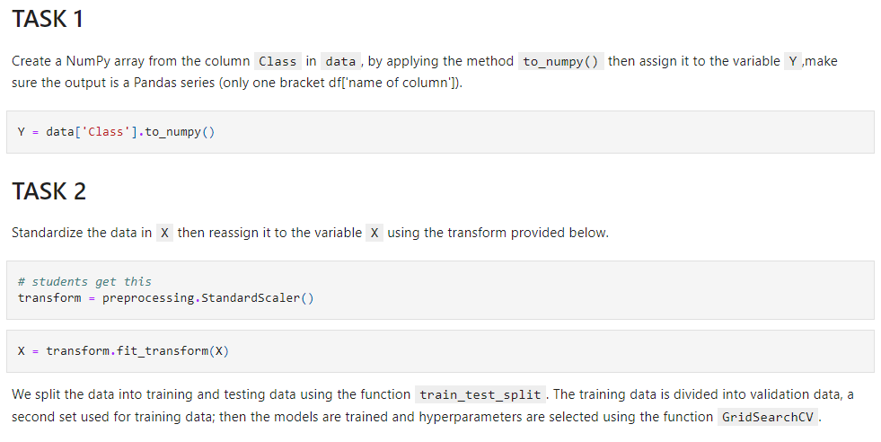
METHODOLOGY | PREDICTIVE ANALYSIS
Methodology Synopsis: Conduct EDA, create a class label column, standardize features, split the data into training and test sets, and use cross-validation for hyperparameter tuning. Evaluate models on various performance metrics to choose the best one.
Exploratory Data Analysis (EDA) and Determining Training Labels: Understand the dataset by summarizing statistics, visualizing distributions, and identifying patterns. Address missing values, outliers, and data types. Define and create the target variable for classification (e.g., churn = 1, no churn = 0).
Creating a Class Column: Add a column for the class label based on the target variable, which will be used as the output in machine learning models. Address any class imbalance using techniques like oversampling or undersampling to enhance model performance.
Standardizing the Data: Transform the features to have a mean of 0 and a standard deviation of 1. This ensures that all features are on the same scale, which is crucial for algorithms sensitive to feature scales, like SVM and Logistic Regression.

Slide 13
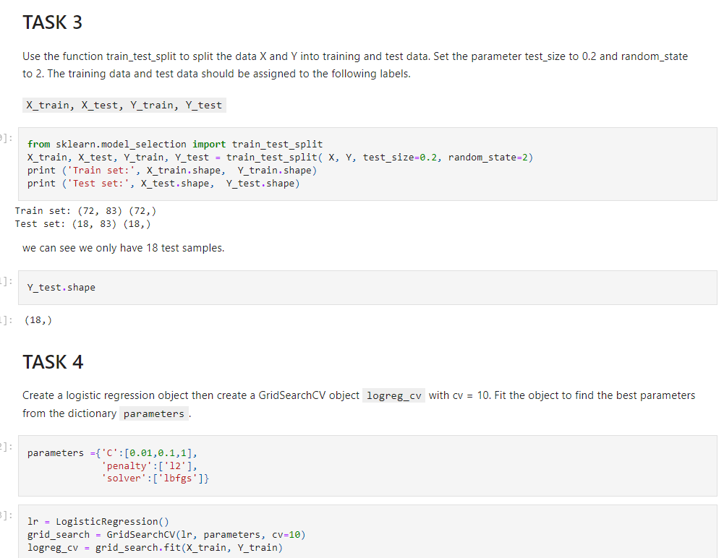
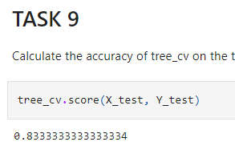
METHODOLOGY | PREDICTIVE ANALYSIS
Splitting into Training and Test Data: Divide the dataset into training (e.g., 70%) and test sets (e.g., 30%). The training set is used to build models, while the test set evaluates their performance to assess generalization.
Hyper Tuning :Optimize model performance by tuning hyperparameters using techniques such as Grid Search or Random Search with cross-validation. Adjust parameters like kernel type for SVM, tree depth for Classification Trees, and regularization strength for Logistic Regression..
Evaluating Model Performance: Compare models based on metrics such as accuracy, precision, recall, F1-score, and ROC-AUC. Consider model interpretability, speed, and scalability to select the most effective model.

Slide 14
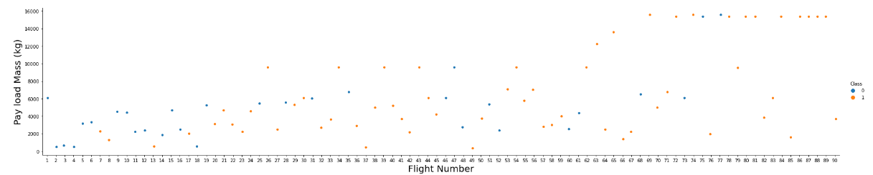
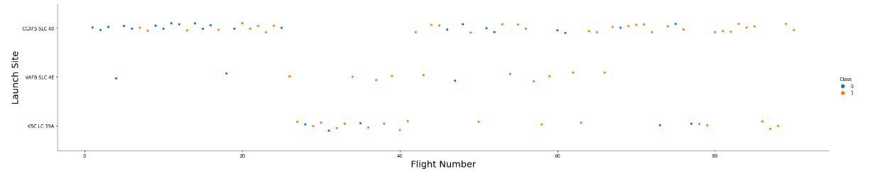
RESULTS | EDA WITH VISUALIZATION
Payload Mass VS Flight Number
We see that different launch sites have different success rates. CCAFS LC-40, has a success rate of 60 %, while KSC LC-39A and VAFB SLC 4E has a success rate of 77%
Now if you observe Payload Vs. Launch Site scatter point chart you will find for the VAFB-SLC launch site there are no rockets launched for heavy payload mass(greater than 10000).
Launch Site VS Flight Number

Slide 15
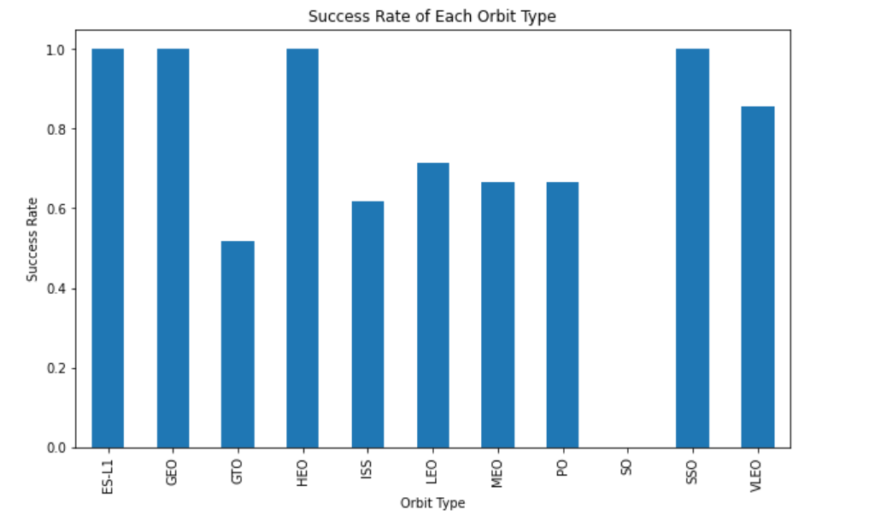
RESULTS | EDA WITH VISUALIZATION
Orbit:
GEO,
HEO,
SSO,
ES-L1
They have the best Success Rate

Slide 16
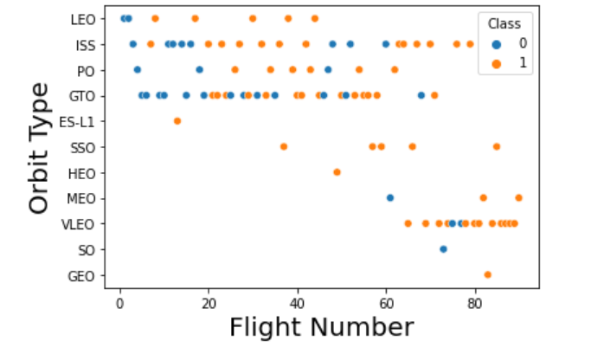
RESULTS | EDA WITH VISUALIZATION
Orbit Type VS Flight Number
LEO Success: Related to flight number. GTO Success: No apparent relationship to flight number.

Slide 17
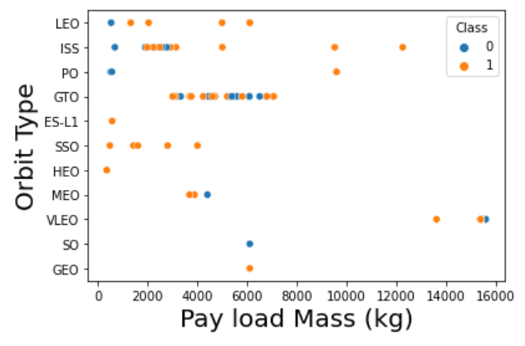
RESULTS | EDA WITH VISUALIZATION
Orbit Type VS Pay Load
Heavy payloads: Negative impact on GTO, positive impact on GTO and Polar LEO (ISS).

Slide 18
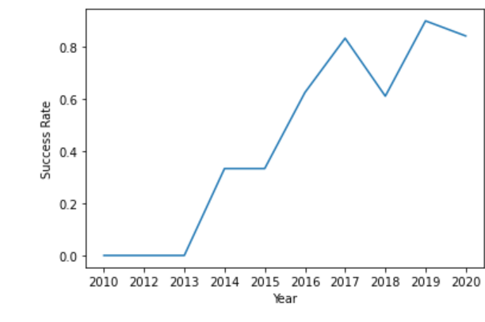
RESULTS | EDA WITH VISUALIZATION
Success Rate VS Year
Yearly Success Rate:
Success rate since 2013 has been increasing till 2020

Slide 19
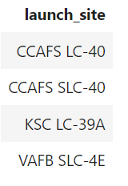

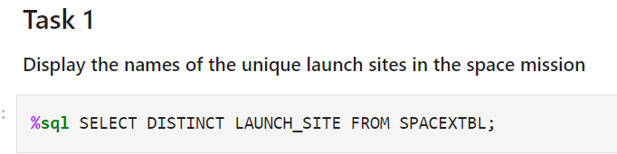
RESULTS | EDA WITH SQL
SQL QUERY FOR NAMES OF THE UNIQUE LAUNCH SITES
Definition:
The DISTINCT keyword in SQL is used to return only unique (different) values from a column or combination of columns in a query result. It removes duplicate records.
Importance:
Ensures data accuracy by filtering out duplicates.
Optimizes query results for analysis by providing a clear dataset.
Improves performance in some cases by reducing the result size.

Slide 20
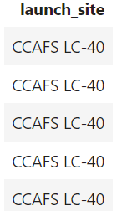
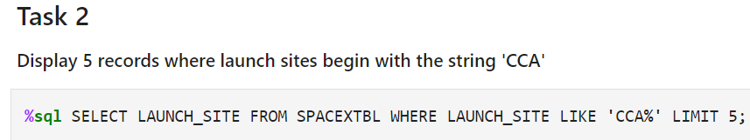
RESULTS | EDA WITH SQL
SQL QUERY FOR 5 RECORDS WHERE LAUNCH SITES BEGIN
Launch_Site.
Importance:
Identifying the launch site is crucial in the context of space missions or logistics because it affects the trajectory, payload capacity, costs, and success probability of a launch. The location determines the orbital paths available, weather conditions, regulatory considerations, and operational logistics.

Slide 21
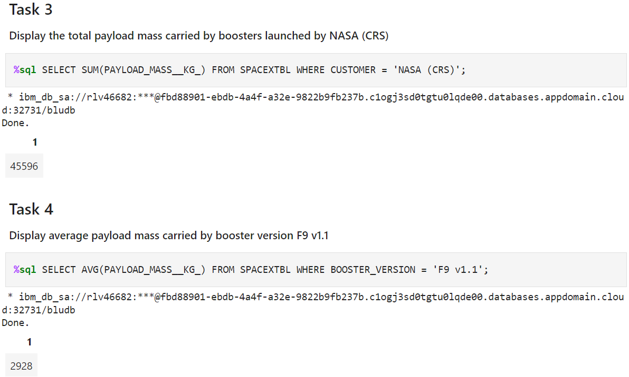
RESULTS | EDA WITH SQL
SQL QUERY FOR:
Task3
Total payload mass carried by boosters
Task 4
Average payload mass carried by booster version F9 v1.1

Slide 22
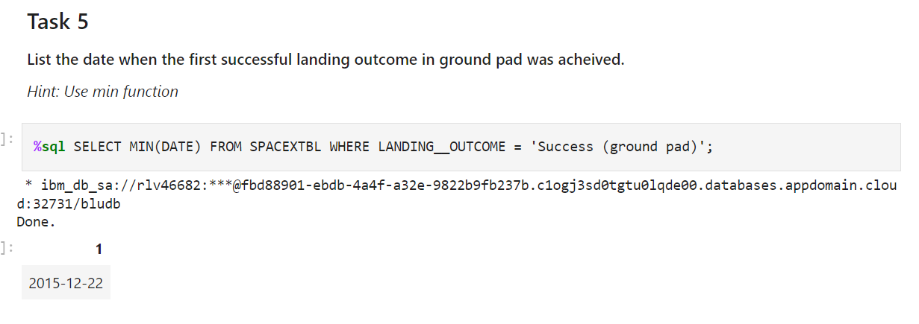
RESULTS | EDA WITH SQL
SQL QUERY FOR LIST THE DATE WHEN THE FIRST SUCCESSFUL LANDING OUTCOME IN GROUND PAD WAS ACHIEVED
Min Function.
Importance:
The MIN function in SQL returns the smallest value from a specified column in a dataset. It is important because it allows for quick identification of the minimum value in large datasets, which is useful in analytics, reporting, and data validation tasks

Slide 23
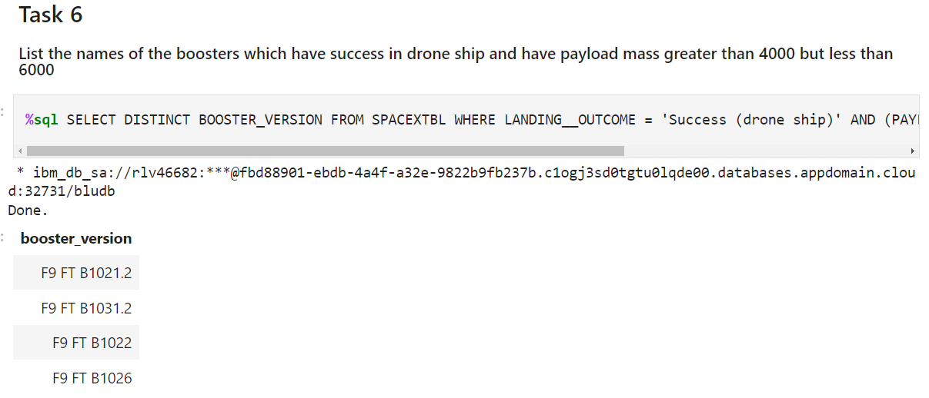
RESULTS | EDA WITH SQL
SQL QUERY FOR LIST THE NAMES OF THE BOOSTERS WHICH HAVE SUCCESS IN DRONE SHIP AND HAVE PAYLOAD MASS GREATER THAN 4000 BUT LESS THAN 6000
Query selects unique values in the booster column

Slide 24
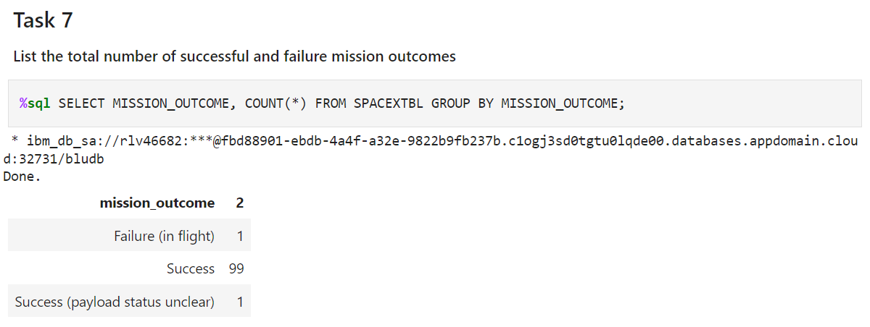
RESULTS | EDA WITH SQL
SQL QUERY FOR TOTAL NUMBER OF SUCCESSFUL AND FAILURE MISSION OUTCOMES
Define:
The COUNT() function in SQL returns the number of rows that match a specified condition in a query. It is commonly used to determine the number of records in a table or the number of non-null values in a column.
Importance:
Data Analysis: Helps quickly summarize and analyze datasets by counting occurrences.
Performance: Efficiently retrieves counts without needing to load all data.
Validation: Ensures data integrity by verifying expected row counts or conditions.

Slide 25
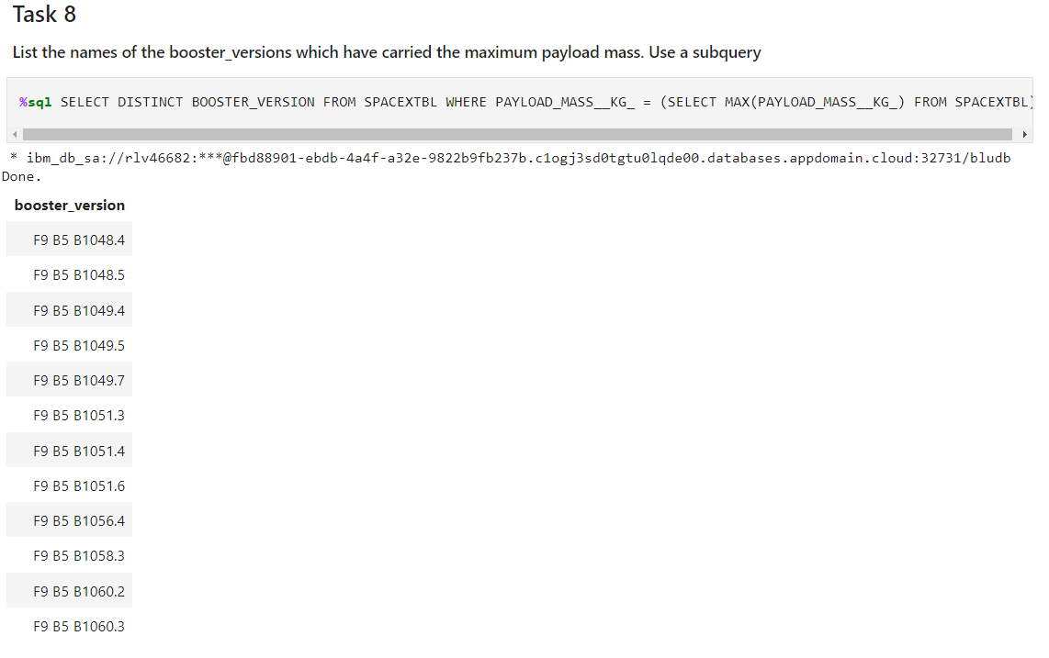
RESULTS | EDA WITH SQL
SQL QUERY FOR THE BOOSTER_VERSIONS WHICH HAVE CARRIED THE MAXIMUM PAYLOAD MASS. USE A SUBQUERY

Slide 26
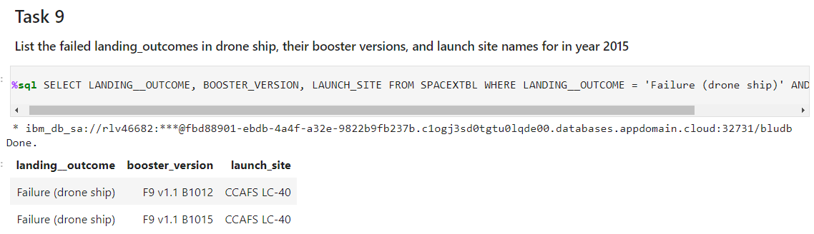
RESULTS | EDA WITH SQL
SQL QUERY FOR the FAILED LANDING_OUTCOMES IN DRONE SHIP, THEIR BOOSTER VERSIONS, AND LAUNCH SITE NAMES FOR IN YEAR 2015

Slide 27
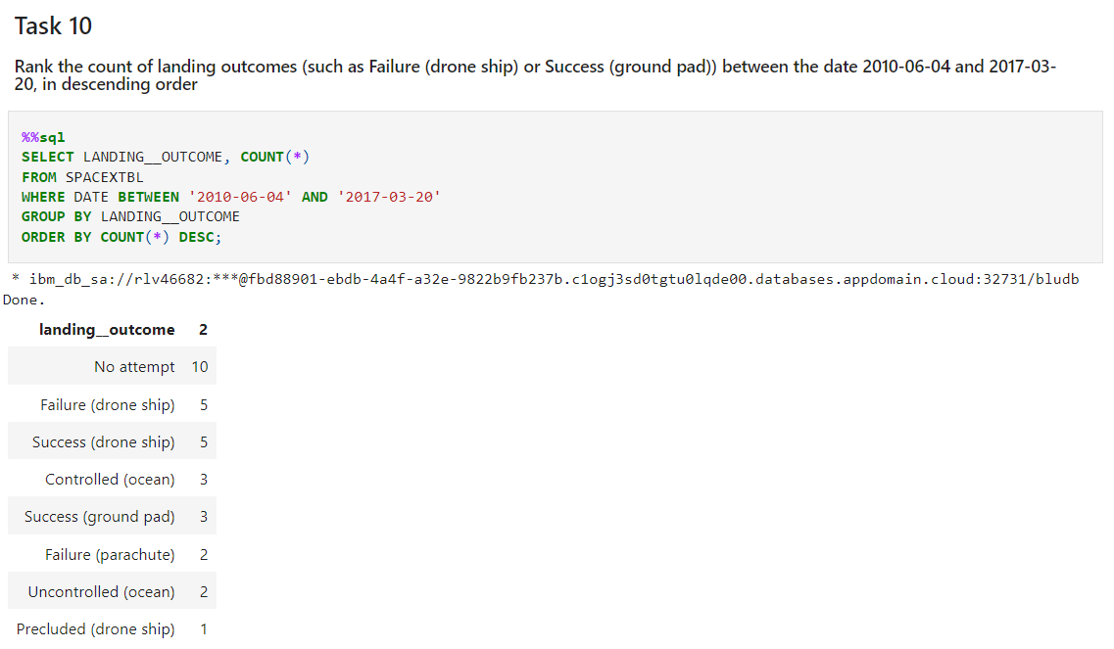
RESULTS | EDA WITH SQL
SQL QUERY FOR RANKING THE COUNT OF LANDING OUTCOMES

Slide 28
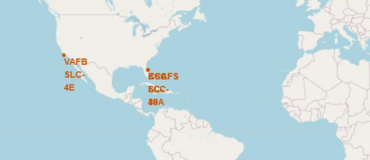
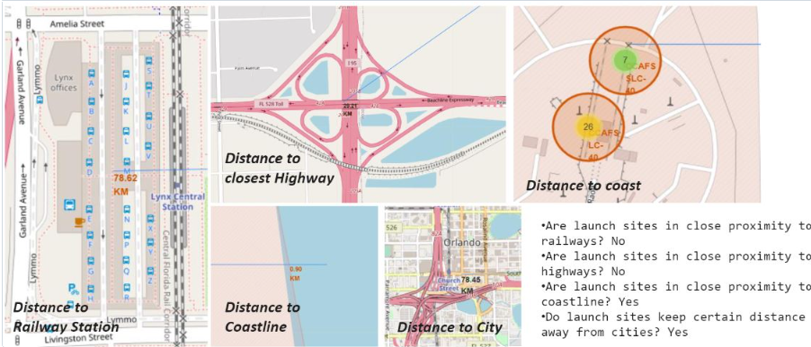
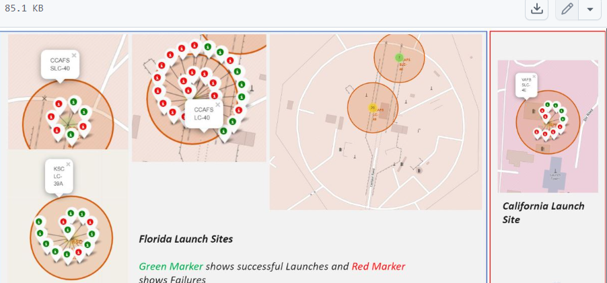
RESULTS | INTERACTIVE MAP WITH FOLIUM RESULTS
Launch sites are in the USA coasts.
Folium is a Python library used for creating interactive maps. It is built on top of Leaflet.js, a leading open-source JavaScript library for interactive maps. Folium enables easy visualization of geospatial data by combining Python data handling capabilities with Leaflet's mapping tools.
Importance of Folium:
Interactive Maps: Enables the creation of interactive maps that can be embedded in Jupyter notebooks or web applications.
Data Visualization: Supports a variety of geospatial data formats, allowing for robust and customizable visualizations.
Integration with Python Ecosystem: Easily integrates with other Python libraries (e.g., pandas, geopandas) for handling and visualizing complex geospatial data.

Slide 29
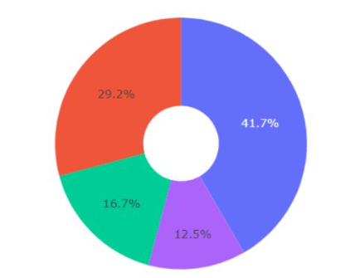
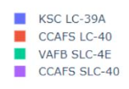
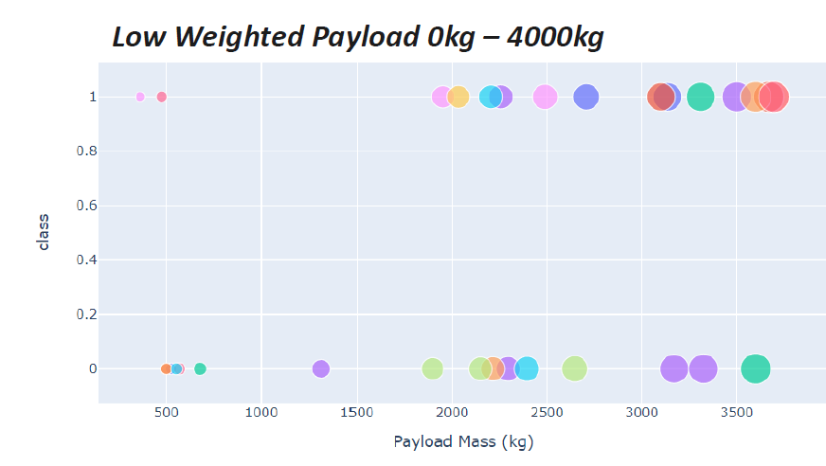
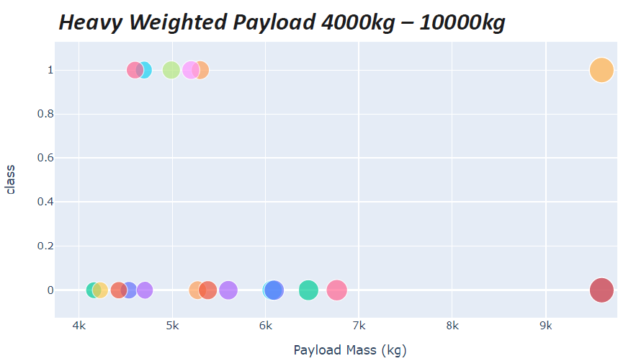
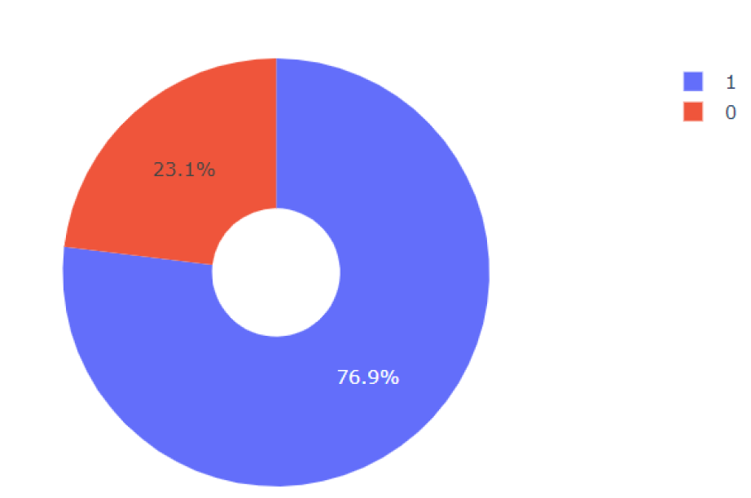
RESULTS | PLOTLY DASH DASHBOARD
KSC LC-39A achieved most successful launches
Success rates are higher for low-weight payloads compared to heavy payloads.
KSC LC-39A achieved a 76.9% success rate and a 23.1% failure rate.

Slide 30
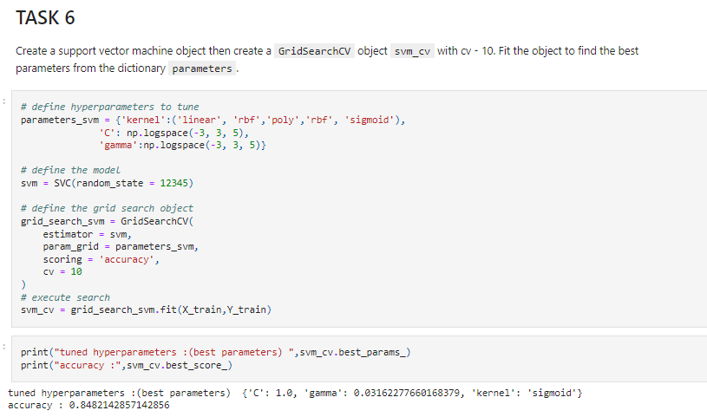
RESULTS | PREDICTIVE ANALYSIS (CLASSIFICATION)
SVM Outcome

Slide 31
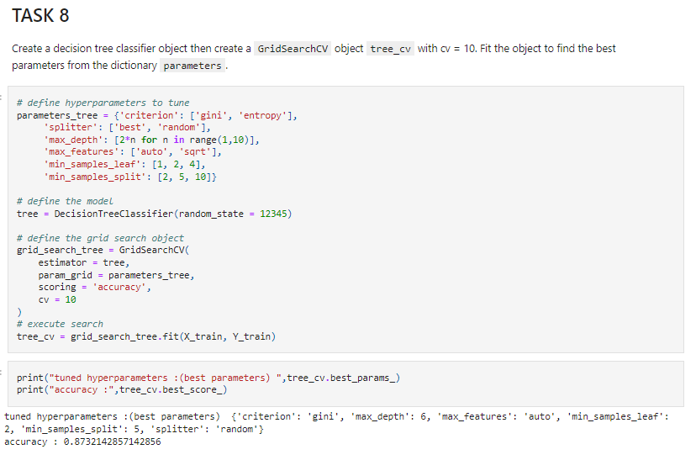
RESULTS | PREDICTIVE ANALYSIS (CLASSIFICATION)
Decision Tree Outcome

Slide 32
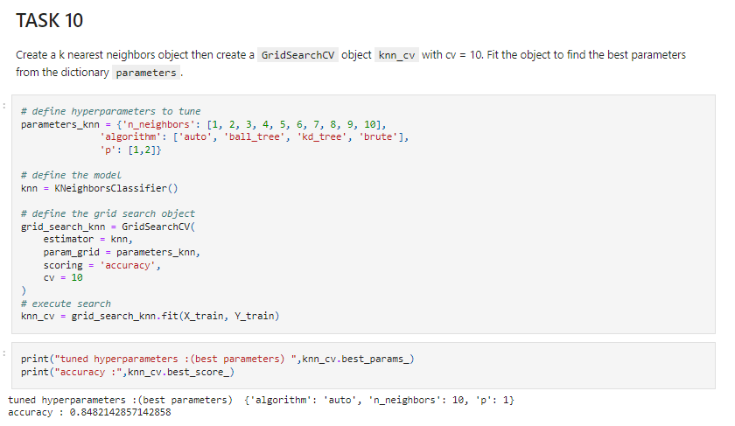
RESULTS | PREDICTIVE ANALYSIS (CLASSIFICATION)
KNN Outcome

Slide 33
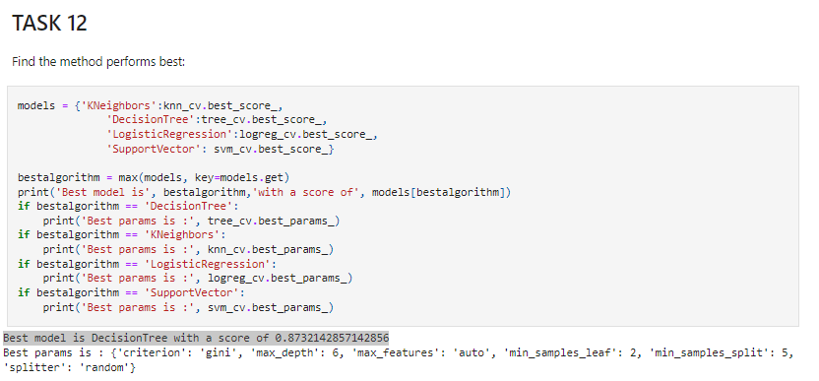
RESULTS | PREDICTIVE ANALYSIS (CLASSIFICATION)
Best
Performer

Slide 34
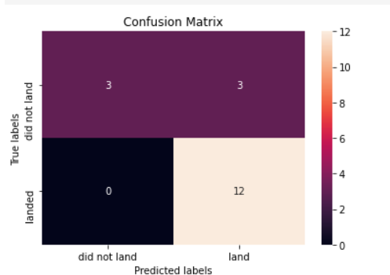
RESULTS |PREDICTIVE ANALYSIS (CLASSIFICATION)
Best model is Decision Tree with a score of 0.8732142857142856
Note:
The confusion matrix shows that the Tree model can distinguish between classes, but it has a significant issue with false positives.

Slide 35

CONCLUSION
Tree Classifier Algorithm: Most effective for predicting SpaceX launch outcomes, handling complex decision boundaries well.
Payload Weight: Lower-weighted payloads perform better than heavier ones, suggesting heavier payloads face more significant challenges.
Success Rates Over Time: SpaceX's launch success rates improve with time, indicating ongoing refinement of technology and processes.
Launch Sites: Kennedy Space Center LC-39A has the highest success rate, reflecting its critical role and advanced facilities.
Optimal Orbits: GEO, HEO, SSO, and ES L1 orbits have the best success rates, highlighting favorable conditions and technological advantages.
Summary: The Tree Classifier Algorithm is best for predicting launch outcomes, with insights into payload performance, launch site effectiveness, and optimal orbits revealing key factors influencing SpaceX's success and continuous improvements.

